Slide 1
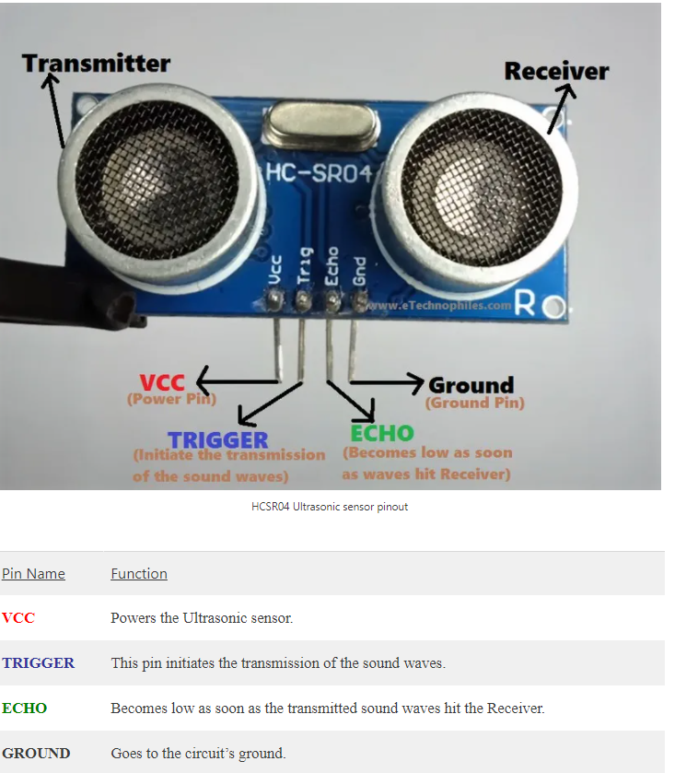
ULTRASONIC SENSOR HCSR04

Slide 2
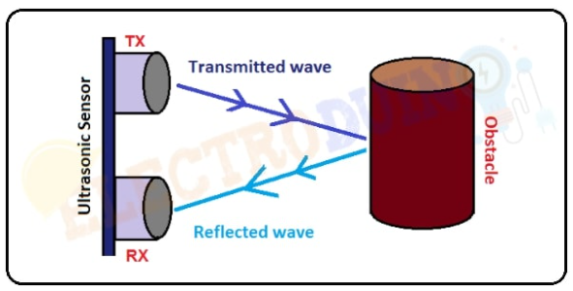
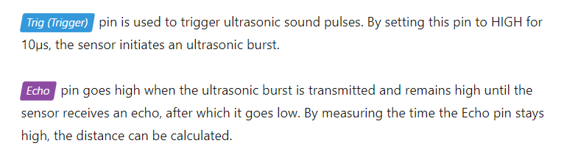
Distance to Obstacle = (Transmitted wave + Reflected wave) / 2

Slide 3
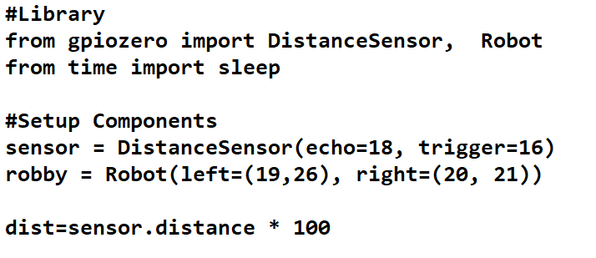
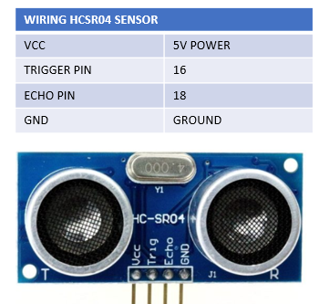
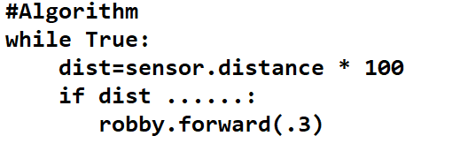

Slide 4
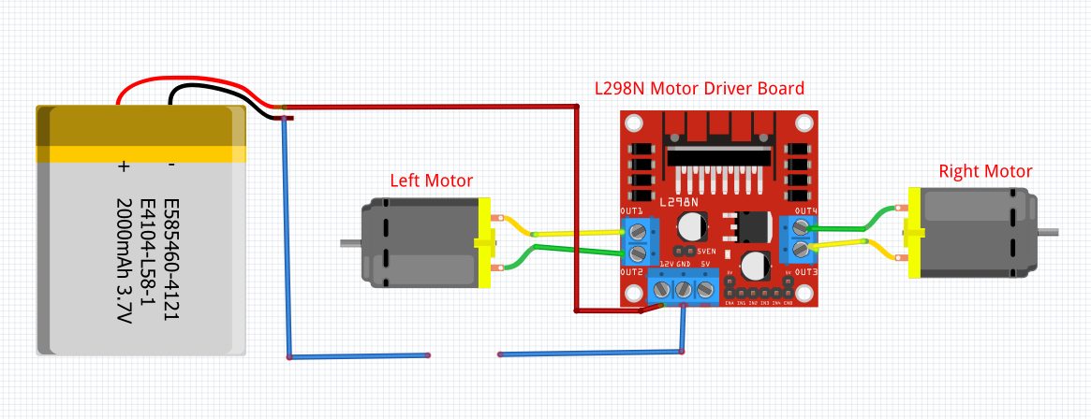
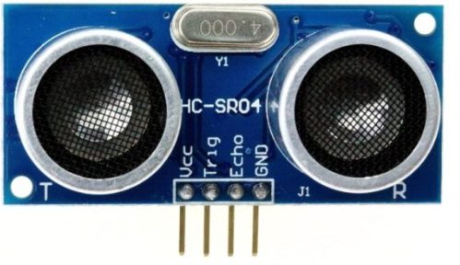
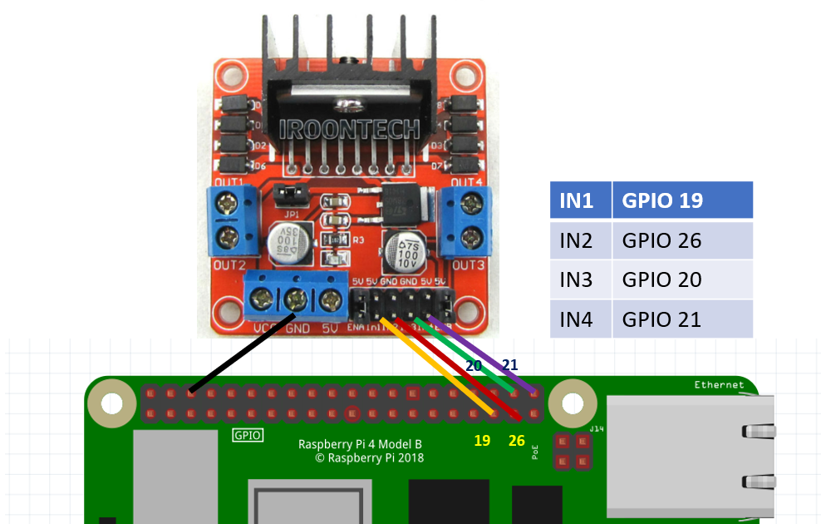
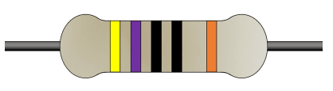
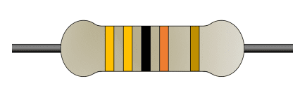
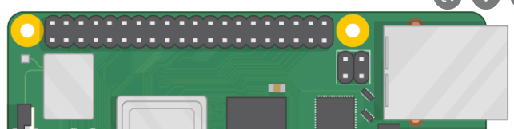
Wiring Diagram for Robot and Ultrasonic Sensor
WIRING HCSR04 SENSOR
VCC | 5V POWER
TRIGGER PIN | 16
ECHO PIN | 18
GND | GROUND
18
330 ohm
VCC
GND
16
470 ohm

Slide 5
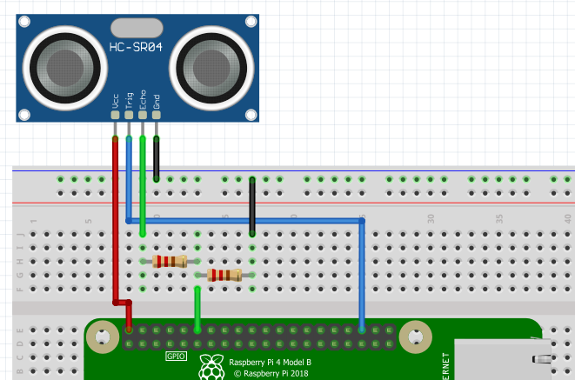
Wiring Diagram for Ultrasonic Sensor
Voltage Divider
To convert 5v to 3v
330 ohm
470 ohm
5V
GND
Pin 18
Pin 16
https://gpiozero.readthedocs.io/en/stable/api_input.html?highlight=distancesensor#gpiozero.DistanceSensor
https://gpiozero.readthedocs.io/en/stable/api_input.html?highlight=distancesensor%5C#distancesensor-hc-sr04

Slide 6
Pi Club 2023
Raspberry Pi Pico WH
https://all3dp.com/2/raspberry-pi-pico-w-h-wh-wifi/
Personal Pico WH
Personal IOT Kit
Laptop

